Slide 1

Leaders in Environment Analysis and Definition of Strategy

Slide 2
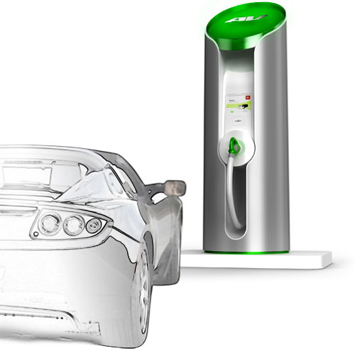
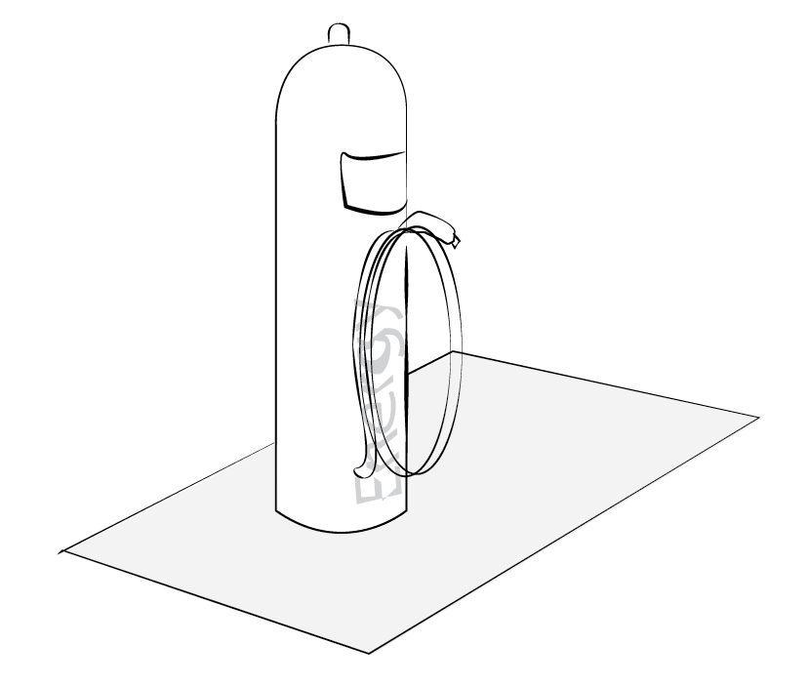
Source: http://www..clubcandoca.com.br

Slide 3
[Countries]

Slide 4
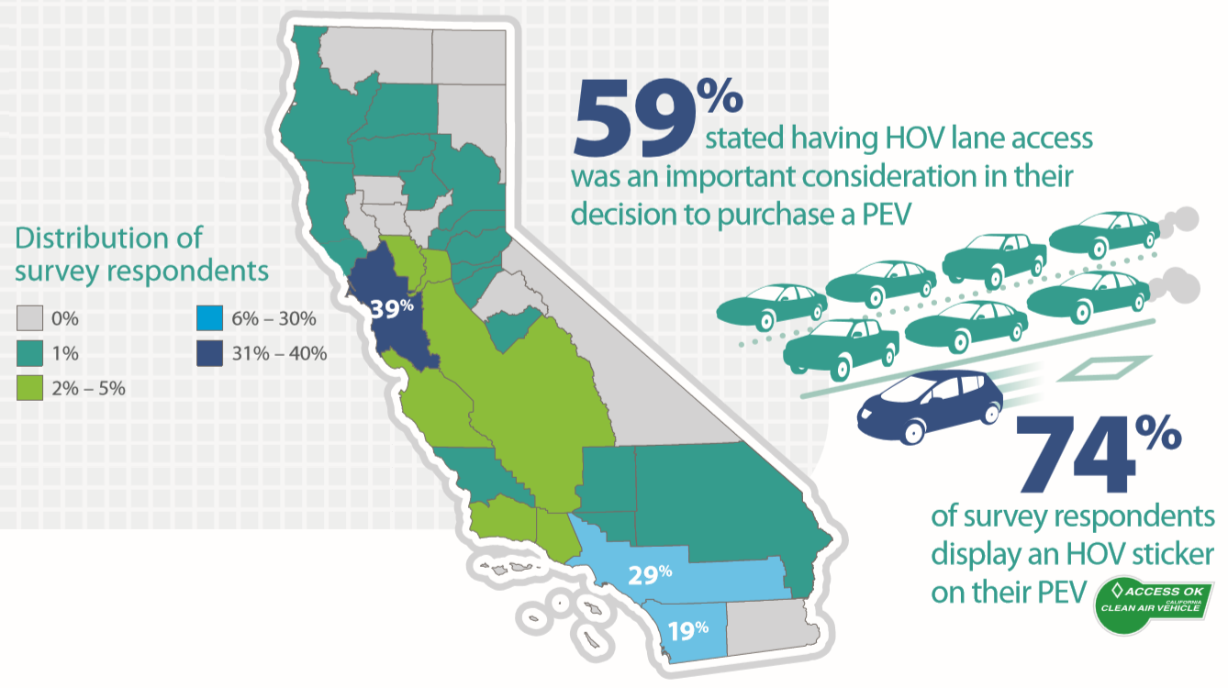

California
Infrastructure
1,207 stations (21.3%)
5,176 (26.6%) public charging points.
71% dissatisfaction with public charging infrastructure
64% level 2 home chargers received free
Incentives
46 (11% in U.S) Evs incentives
HOV lane access was a very important purchase motivation for 59%
Results:
92% overall satisfaction
87% users graduate or postgraduate
Cost is first on deciding charging
Environment and energy independance first reasons

Slide 5
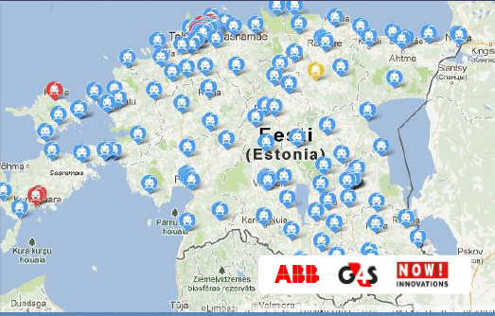
Estonia
Infrastructure
World’s first country to launch a nationwide fast-charging network
Beginning of 2013, 163 fast chargers have been installed
Distance between quick charging points is 40-60 km
Incentives
Up to 18,000 Euros of the all-electric car’s
1,000 Euros support for charging system at home.
Results:
Decreased Ev’s User range anxiety
One electric car registered per each 1,000 cars
Battery can be charged up to 90% in less than 30 minutes

Slide 6
[Companies]

Slide 7

Field/market
Start-up in Israel
Battery swapping
Successful start (market share)
Company strategy
Rely on forecast: provide half of Israelian car market
Lot of money spent on brand promotion
Huge investment to buy batteries but not on cost reduction
Results:
Poor management due to excess of confidence
1,400 cars sold for 100,000 forecast
Losses went to bankruptcy

Slide 8
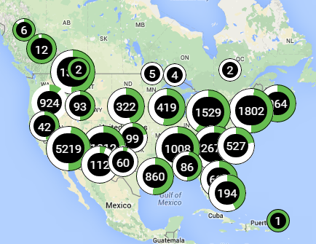

Field/market
US market: 70% market share
Charging stations 1,2, fast
Company strategy
Top of innovation (patents)
No manufacturing; rely on suppliers
Focus on service (app, maintenance, installation, energy optimization)
Chargers adapted to all standards
Rely on brand image
Results:
Very good reputation, extremely visible
Leader in the market
Fast growing sales
But nothing out of the US

Slide 9

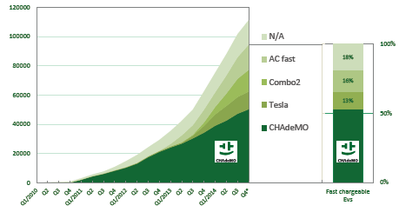
CHAdeMO
Field/market
Association to promote a fast charger standard
At first Japan, now 400 members
Results:
Overall Leading standard (vehicle & stations)
Now in competition with Combo standard (BMW, Volkswagen, GM)
Strategy
First to launch standards and adapted EVs
Team up on standard in order to garantee fierce competition on innovation and price

Slide 10
[Thank you]

Slide 11

Leaders in Environment Analysis and Definition of Strategy

